Slide 1




Presented by:- 7358 Umang Kumar Presented to:- Dr. Sagar Rane
A Blockchain-Based Consent Mechanism for Access to Fitness Data in the Healthcare Context

Slide 2
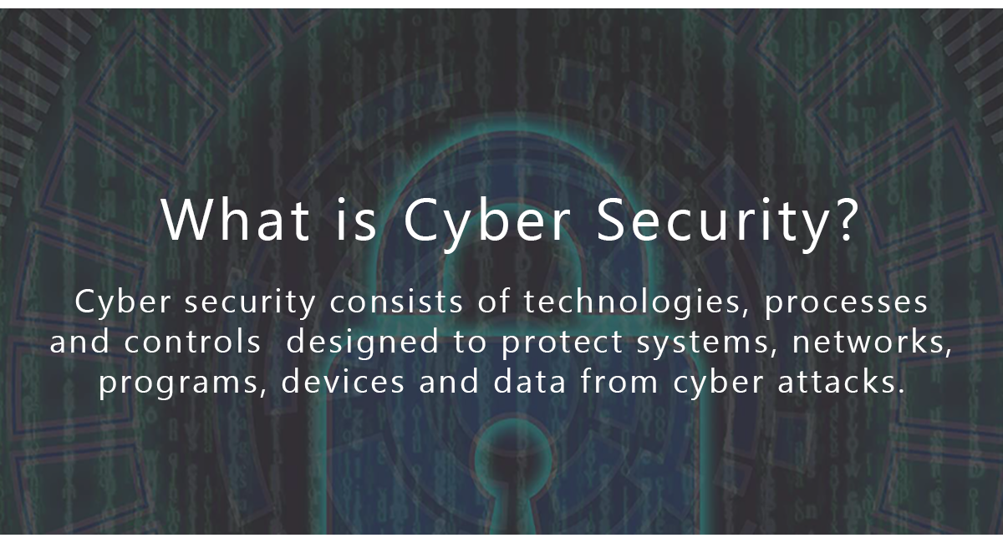
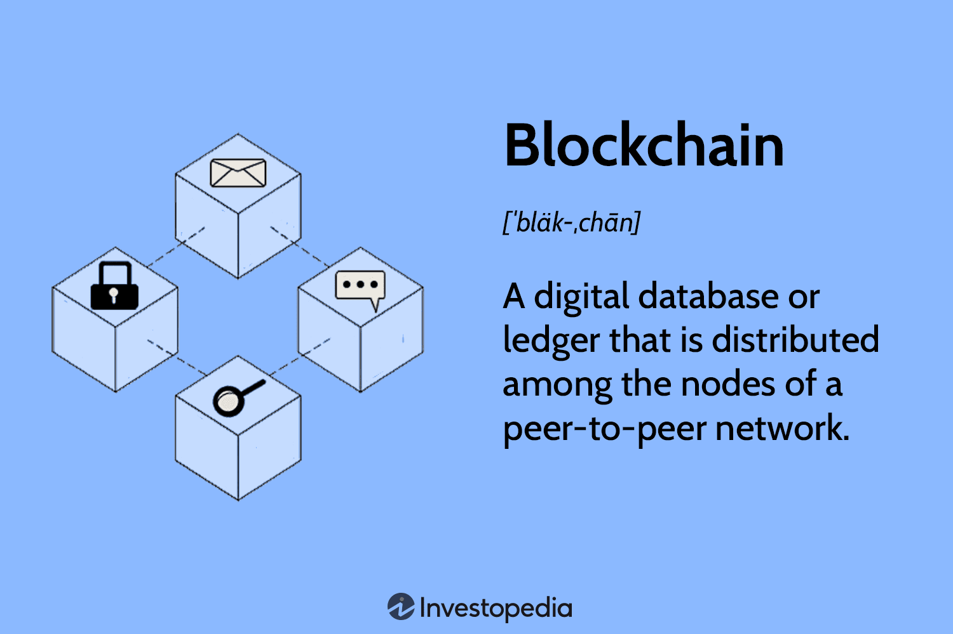
Motivation for the Problem Identified
1
2
1. Cybersecurity is the protection of internet-connected systems such as hardware, software and data from cyberthreats. The practice is used by individuals and enterprises to protect against unauthorized access to data centers and other computerized systems.
2. Blockchain is a shared, immutable ledger that facilitates the process of recording transactions and tracking assets in a business network. An asset can be tangible (a house, car, cash, land) or intangible (intellectual property, patents, copyrights, branding).

Slide 3
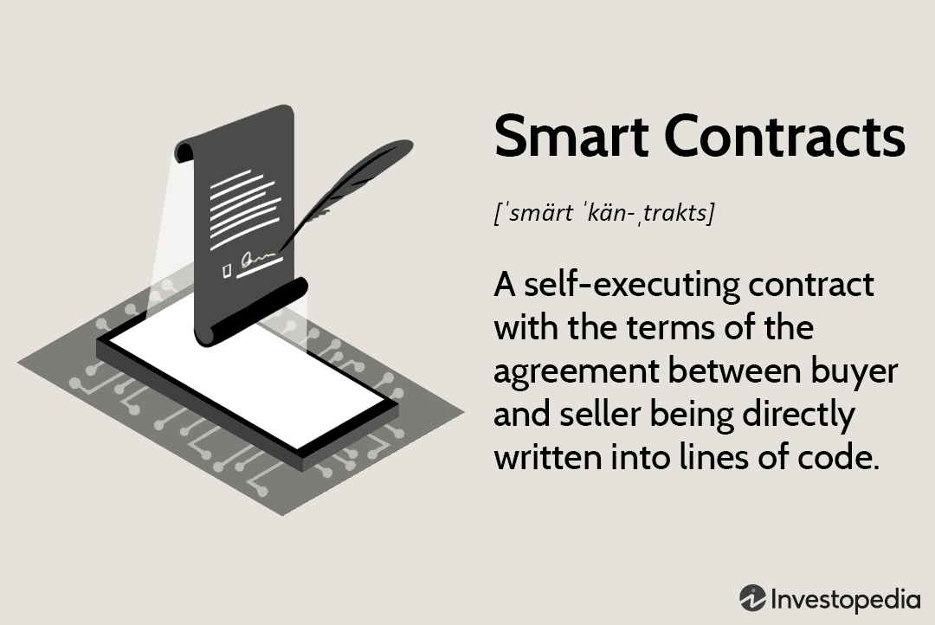
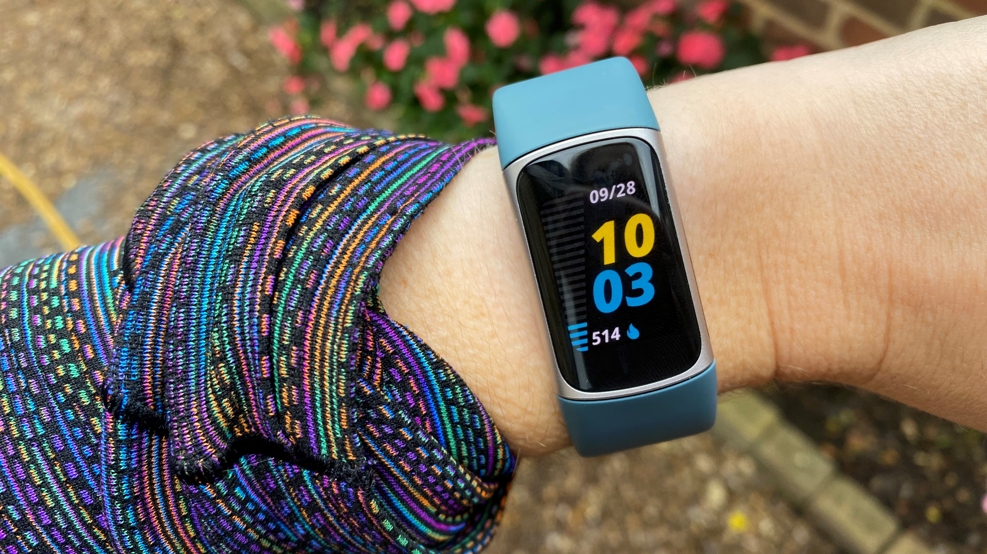
Objectives and Planned Outcomes
1
2
1. Smart Contracts takes up the work of middleman by automating the terms of agreement between both the parties. They can be written in languages such as Solidity on Remix IDE.
2. Wearable fitness devices are widely used to track an individual’s health and physical activities to improve the quality of health services. These devices sense a considerable amount of user sensitive data.

Slide 4
Introduction
Overview
Existing Problems
Notes:
When conducting research, it is easy to go to one source: Wikipedia. However, you need to include a variety of sources in your research. Consider the following sources:
Who can I interview to get more information on the topic?
Is the topic current and will it be relevant to my audience?
What articles, blogs, and magazines may have something related to my topic?
Is there a YouTube video on the topic? If so, what is it about?
What images can I find related to the topic?

Slide 5
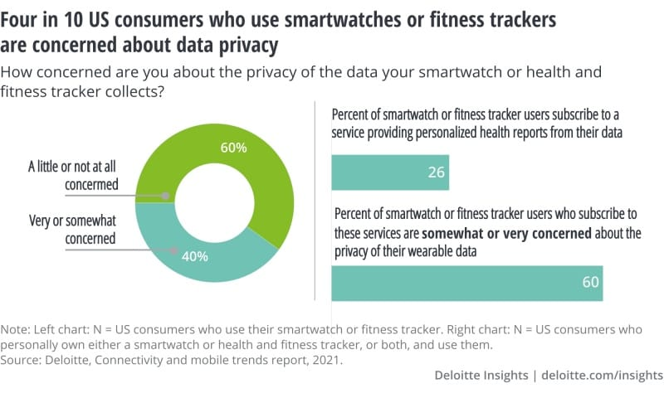
Overview
People are now exposed to a large amount of their own private health information as a result of the more people recently using wearable fitness technology like smart watches.
These wearables monitor a wide range of information, including physiological data and health-related information like blood pressure, steps, and sleep.
The use of these technologies for precise diagnosis benefits patients, doctors, and clinical researchers, but there are some privacy issues that have arisen.
Notes:
When conducting research, it is easy to go to one source: Wikipedia. However, you need to include a variety of sources in your research. Consider the following sources:
Who can I interview to get more information on the topic?
Is the topic current and will it be relevant to my audience?
What articles, blogs, and magazines may have something related to my topic?
Is there a YouTube video on the topic? If so, what is it about?
What images can I find related to the topic?

Slide 6
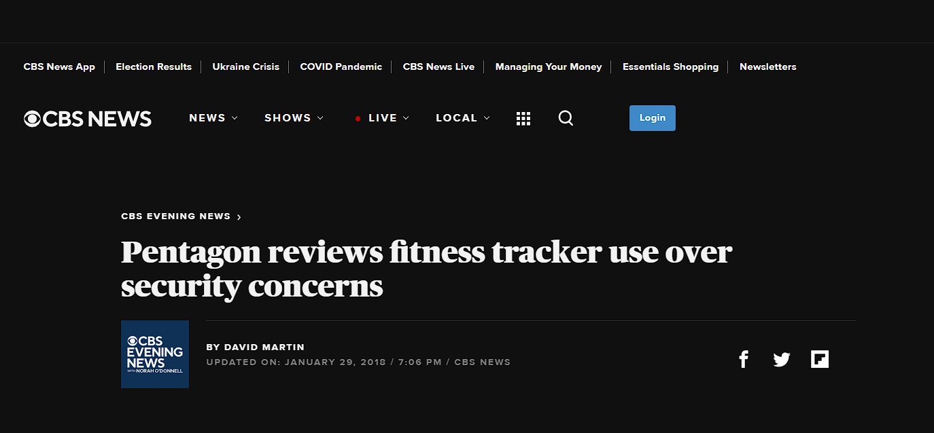
Existing Problems
The way in which these wearables connect to our smartphones such as Bluetooth and Wi-fi hackers can ‘sniff‘ sensitive Bluetooth data. E.g., Under Armour’s MyFitnessPal
Variety of things can get exposed such as location and other fitness standard while these wearables sync with other hardware devices such as PC’s. E.g., Strava
Many privacy-preserving solutions rely on a single reliable source or are opaque to users, such as those that only allow for a single permission with no right to revoke.
Notes:
When conducting research, it is easy to go to one source: Wikipedia. However, you need to include a variety of sources in your research. Consider the following sources:
Who can I interview to get more information on the topic?
Is the topic current and will it be relevant to my audience?
What articles, blogs, and magazines may have something related to my topic?
Is there a YouTube video on the topic? If so, what is it about?
What images can I find related to the topic?

Slide 7

Literature Survey
Proposition
Implementation
Algorithms
Notes:
Once you find your sources, you will want to evaluate your sources using the following questions:
Author:
Who is the author?
Why should I believe what he or she has to say on the topic?
Is the author seen as an expert on the topic? How do you know?
Current:
How current is the information in the source?
When was the source published?
Is the information out-of-date?
Accuracy:
Is the content accurate?
Is the information presented objectively? Do they share the pros and cons?

Slide 8
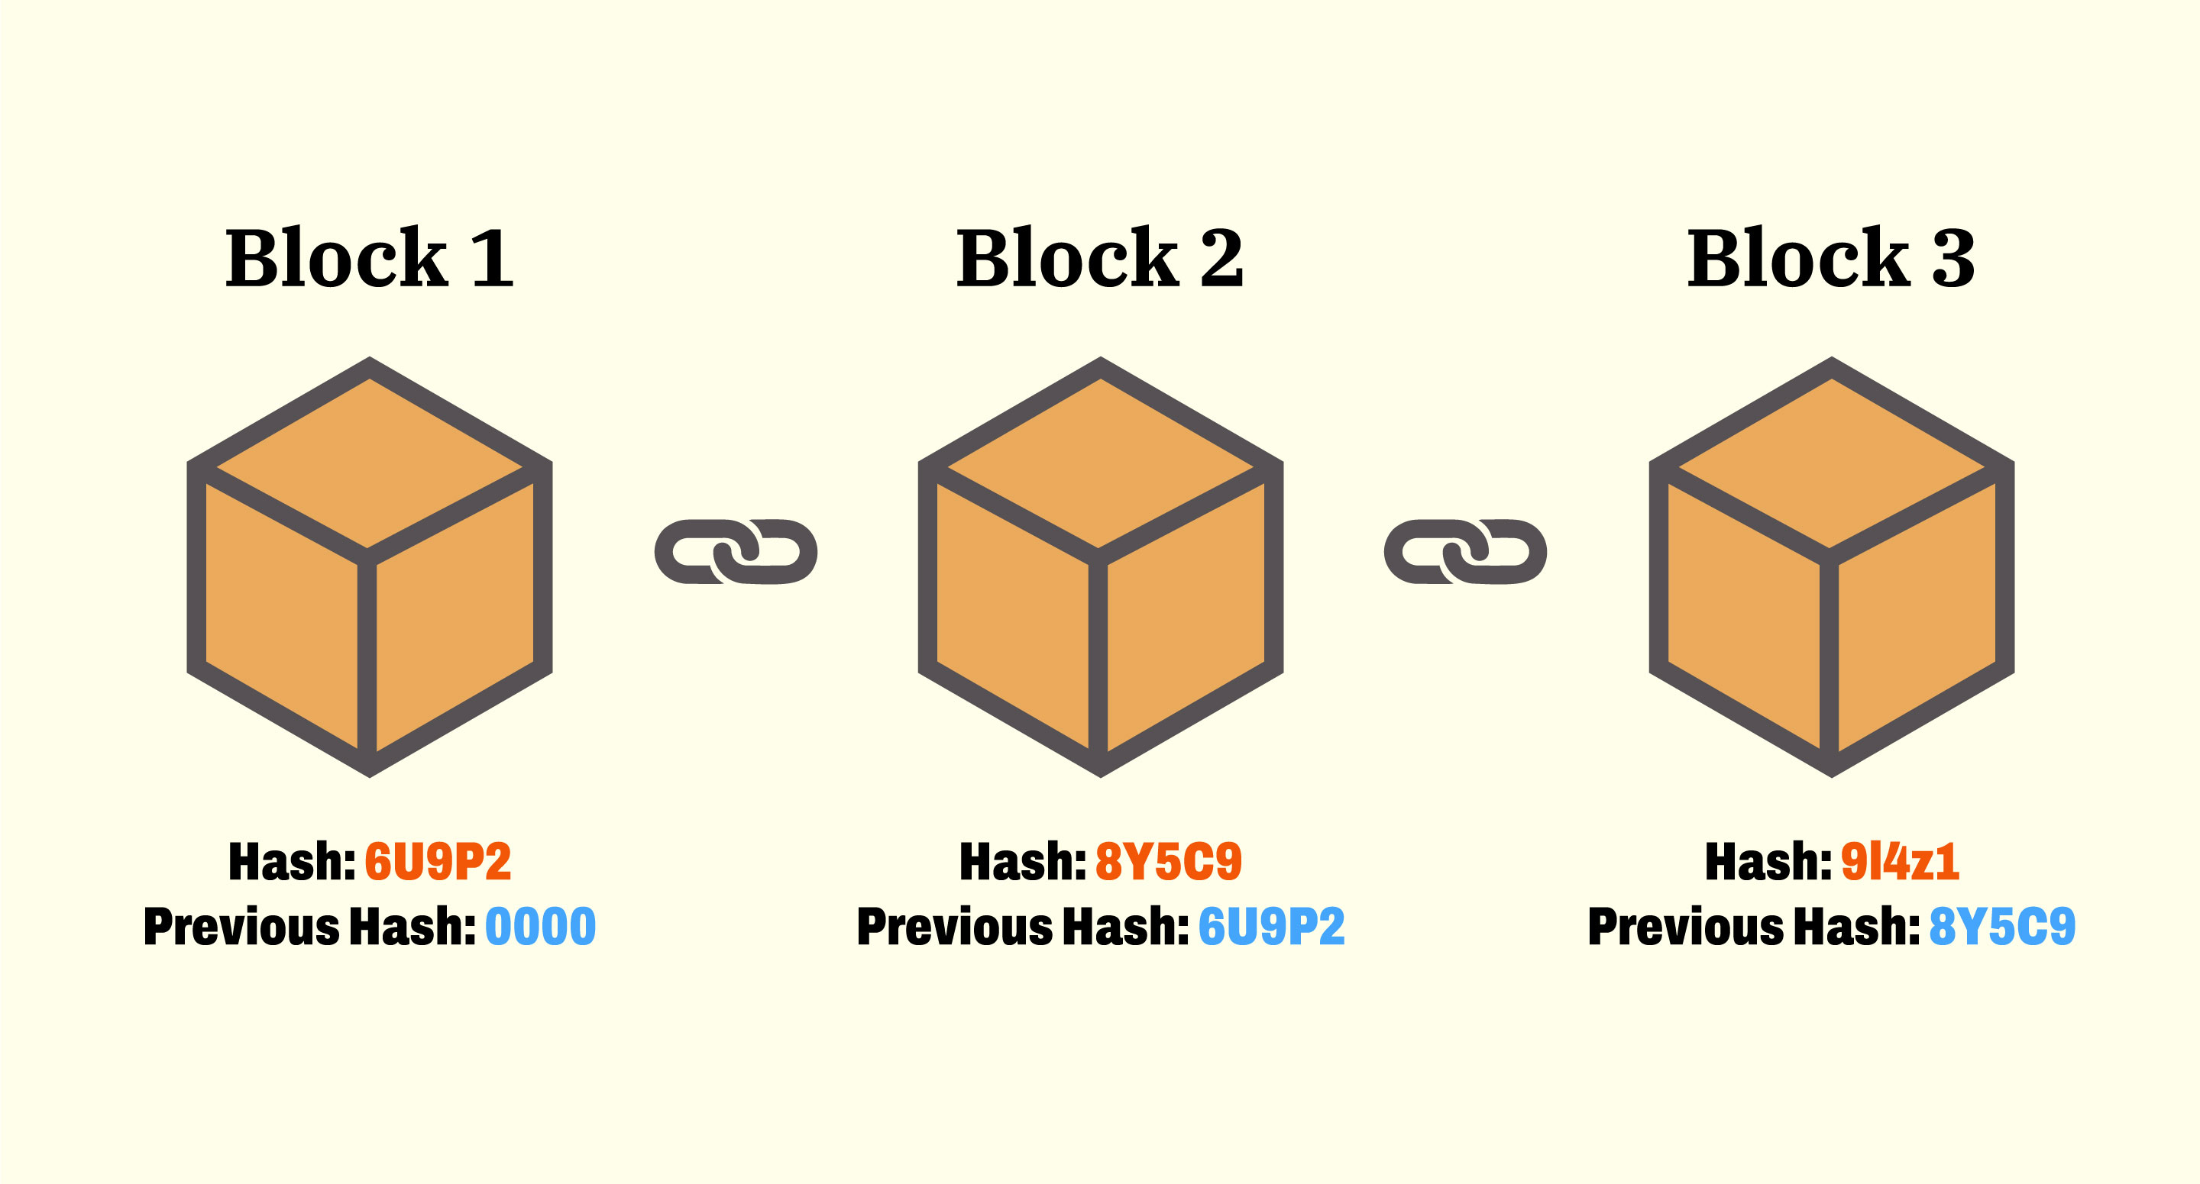
Proposition
The built-in features of blockchain make it a suitable candidate for addressing above mentioned consensual problems.
The following is a list of the benefits of moving fitness provider consent management to a blockchain platform:
Transparency
Security
Scalability
Authorization
Notes:
When conducting research, it is easy to go to one source: Wikipedia. However, you need to include a variety of sources in your research. Consider the following sources:
Who can I interview to get more information on the topic?
Is the topic current and will it be relevant to my audience?
What articles, blogs, and magazines may have something related to my topic?
Is there a YouTube video on the topic? If so, what is it about?
What images can I find related to the topic?

Slide 9
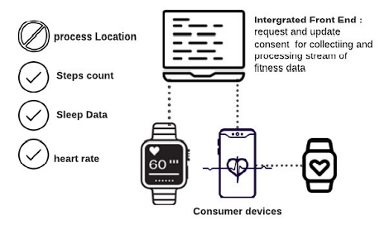
Implementation
One way to prevent such occurrences is to record the user’s device privacy settings in the blockchain, which ensures that all data acquisition is performed in a legitimate manner based on both user consent and device settings.
The proposed system acts as a legitimate legal archive in which all consent and data-sharing-related activities are recorded on the blockchain for auditing purposes. In the case of dispute/conflict or noncompliance, this process automatically forces both fitness providers and data requesters to comply with the legal framework when they acquire consent from users to process or collect their fitness data.
Notes:
When conducting research, it is easy to go to one source: Wikipedia. However, you need to include a variety of sources in your research. Consider the following sources:
Who can I interview to get more information on the topic?
Is the topic current and will it be relevant to my audience?
What articles, blogs, and magazines may have something related to my topic?
Is there a YouTube video on the topic? If so, what is it about?
What images can I find related to the topic?

Slide 10
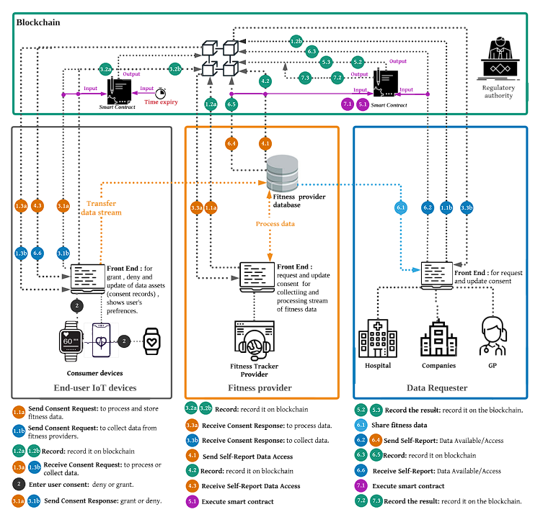
Implementation
Notes:
When conducting research, it is easy to go to one source: Wikipedia. However, you need to include a variety of sources in your research. Consider the following sources:
Who can I interview to get more information on the topic?
Is the topic current and will it be relevant to my audience?
What articles, blogs, and magazines may have something related to my topic?
Is there a YouTube video on the topic? If so, what is it about?
What images can I find related to the topic?

Slide 11
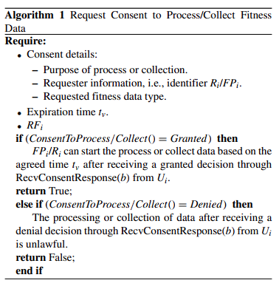
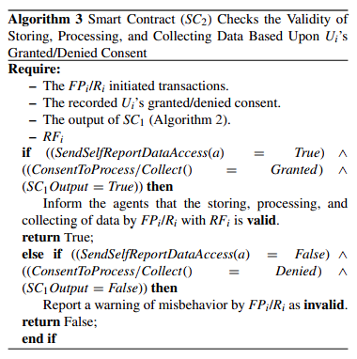
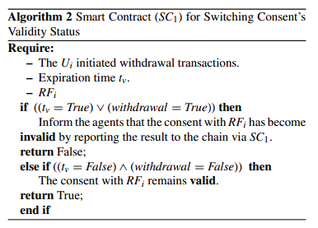
Algorithms
Notes:
When conducting research, it is easy to go to one source: Wikipedia. However, you need to include a variety of sources in your research. Consider the following sources:
Who can I interview to get more information on the topic?
Is the topic current and will it be relevant to my audience?
What articles, blogs, and magazines may have something related to my topic?
Is there a YouTube video on the topic? If so, what is it about?
What images can I find related to the topic?

Slide 12
Analysis
Security Analysis
Notes:
After consulting a variety of sources, you will need to narrow your topic. For example, the topic of internet safety is huge, but you could narrow that topic to include internet safety in regards to social media apps that teenagers are using heavily. A topic like that is more specific and will be relevant to your peers. Some questions to think about to help you narrow your topic:
What topics of the research interest me the most?
What topics of the research will interest my audience the most?
What topics will the audience find more engaging? Shocking? Inspiring?

Slide 13
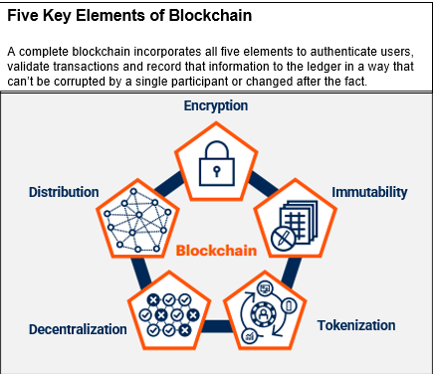
Security Analysis
Authentication
Data Integrity
Non-repudiation
Confidentiality
Informed
Specific
Notes:
After consulting a variety of sources, you will need to narrow your topic. For example, the topic of internet safety is huge, but you could narrow that topic to include internet safety in regards to social media apps that teenagers are using heavily. A topic like that is more specific and will be relevant to your peers. Some questions to think about to help you narrow your topic:
What topics of the research interest me the most?
What topics of the research will interest my audience the most?
What topics will the audience find more engaging? Shocking? Inspiring?

Slide 14
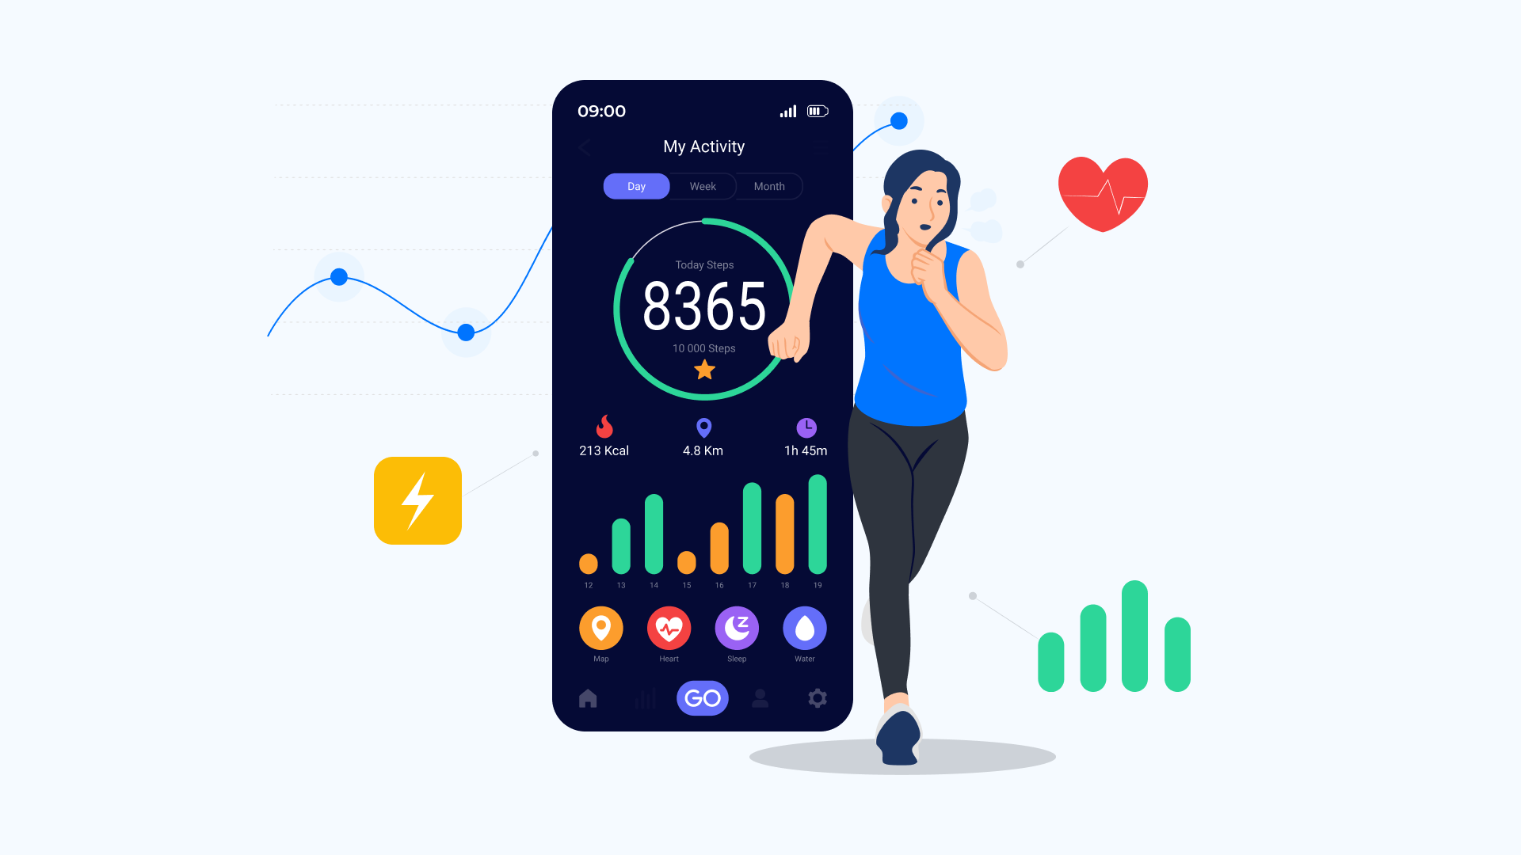
Conclusion
The formal proof model, requirements specification, and system architecture are the main artefacts in the suggested system.
By enhancing user control over the processing of fitness data, we get to the conclusion that the suggested method is suitable for protecting user privacy.
Further study is necessary to close the remaining gap, which is that fitness trackers must accurately send their real processing actions to the blockchain.
Notes:
Now, that you have narrowed your topic, you will want to organize your research in a structure that works. There are some common organizational patterns based on the kind of research you are doing.
Organizational Structures:
Cause and Effect- this kind of structure is great for explaining the causes and effects of a topic
Compare and Contrast- in this pattern you highlight the similarities and differences of the topic
Explain process- this structure is great for outlining a series of steps to follow;
Definition- if you want to make sure your audience understands what something is using illustrations, meanings, clarifying misconceptions, you may want to use this structure
Classification- a common organizational structure is grouping like topics or facts from the research together. For instance, in the internet safety about social media apps, you may organize the research where you look at each social media app one at a time

Slide 15
References
Strava. (2020). Strava Privacy Policy. [Online]. Available: https://www. strava.com/legal/privacy_full_policy
S. Breen, K. Ouazzane, and P. Patel, ‘‘GDPR: Is your consent valid?’’ Bus. Inf. Rev., vol. 37, no. 1, pp. 19–24, Mar. 2020.
Fitness Tracker Privacy Risks (kaspersky.com)
A. Sunyaev, T. Dehling, P. L. Taylor, and K. D. Mandl, ‘‘Availability and quality of mobile health app privacy policies,’’ J. Amer. Med. Inform. Assoc., vol. 22, no. e1, pp. e28–e33, Apr. 2015.
M. M. Madine, A. A. Battah, I. Yaqoob, K. Salah, R. Jayaraman, Y. Al-Hammadi, S. Pesic, and S. Ellahham, ‘‘Blockchain for giving patients control over their medical records,’’ IEEE Access, vol. 8, pp. 193102–193115, 2020.
Notes:
After you’ve done your research, it’s time to put your presentation together. The first step in the process is to introduce the topic. This is a great time to connect your topic to something that your audience can relate. In other words, why should they listen to all the information you will be sharing in your research presentation? What is in it for them? You may also want to include a graphic or image to grab their attention.
Feel free to duplicate this slide by right-clicking on this slide in the slides pane to the left and select Duplicate Slide.
The next step in your presentation is to state your claim or topic clearly. Your teacher may even call this your thesis. As you state your thesis, you may find that this layout is not the best layout for your claim or topic. You can change the layout by clicking the drop-down menu next to the Layout in the Slides menu section. You can choose Two Content, Comparison, or Picture with Caption. Note: A different layout might change the look of the icons on this page.
You will also want to state your facts. You have done the research now share some of the interesting facts with your audience. Facts do not have to be boring; you can communicate facts in a variety of ways by going to the Insert Tab. In the Insert tab you can:
Insert pictures from your computer or online.
Add a chart
Create some SmartArt
Insert a variety of icons to help your facts come to life. Note: You can change the color of the icons by selecting the icon and then click on the Format tab and then Graphics Fill. From there, you will choose a color from the list or choose More Fill Colors to give you more options.
Since this research presentation is a result of your hard work and searching, you want to make sure you support the claims or points in your presentation with facts from your research findings. Make sure you give the author proper credit for helping you share your ideas. If one of your sources has a video that is relevant to your topic, you can add the video as added support. Keep in mind the length of the video and the amount of time you have for your presentation. For a 5 minute speech, the video should be no longer than 30 seconds.
Questions to consider:
How will you state the author of the source?
Will you need to cite the source on the slide?
What are some ways you can engage your audience so they feel like they are a part of the presentation? Some ideas to consider is by taking a quick poll like: by a show of hands, how many of you think school uniforms are a way to cut down on bullying? Another suggestion is to have them hold up a certain number of fingers to see if they agree or disagree. Finally, you can share a story that the audience can relate to that makes them laugh.
After all the applause, your audience may have some questions. Be prepared to answer some of their questions by making a list of questions you think they might ask. You may also want to share the presentation with them by providing the link to your presentation, if they want more information.

Slide 16
Research Presentation End
Thank you
Notes:
You can use this slide as your opening or closing slide. Should you choose to use it as a closing, make sure you review the main points of your presentation. One creative way to do that is by adding animations to the various graphics on a slide. This slide has 4 different graphics, and, when you view the slideshow, you will see that you can click to reveal the next graphic. Similarly, as you review the main topics in your presentation, you may want each point to show up when you are addressing that topic.
Add animation to images and graphics:
Select your image or graphic.
Click on the Animations tab.
Choose from the options. The animation for this slide is “Split”. The drop-down menu in the Animation section gives even more animations you can use.
If you have multiple graphics or images, you will see a number appear next to it that notes the order of the animations.
Note: You will want to choose the animations carefully. You do not want to make your audience dizzy from your presentation.

